Slide 1
Glomerular diseases
Emad abokhabar
Lecturer of Internal medicine and nephrology
Sohag university

Slide 2
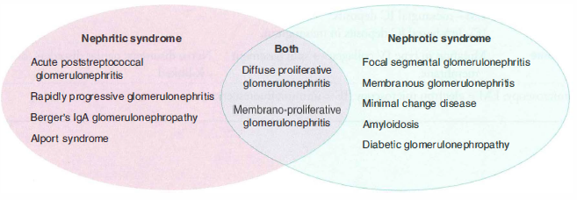
Glomerular diseases

Slide 3
Nephritic syndrome

Slide 4
Acute post streptococcal GN

Slide 5
Rapidly progressive GN(RPGN)

Slide 6
RPGN

Slide 7
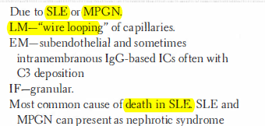
Diffuse proliferative GN

Slide 8
Burger ’s disease (IgA nephropathy)

Slide 9
Alport syndrome

Slide 10
Nephrotic syndrome

Slide 11
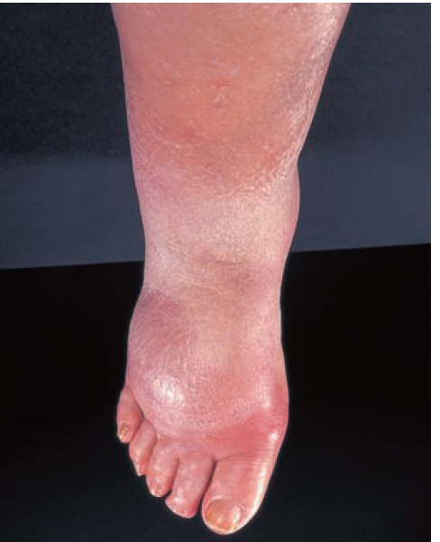
Nephrotic syndrome

Slide 12
Focal segmental GN

Slide 13
Membranous GN

Slide 14
Minimal change GN

Slide 15
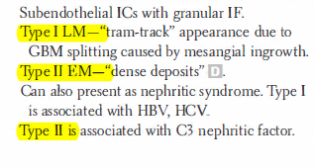
Membrano-proliferative GN

Slide 16
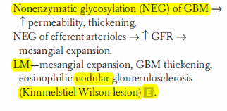
Diabetic GN

Slide 17
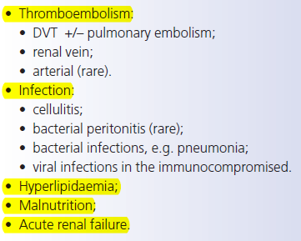
Complications of NS

Slide 18
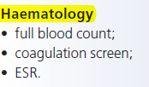
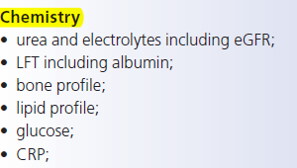
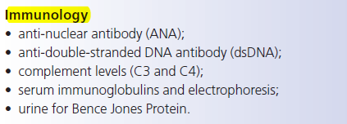
Investigations of NS

Slide 19
Investigations of NS

Slide 20
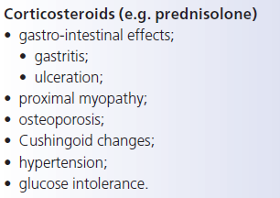
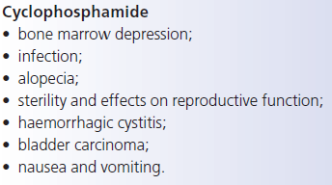
Treatment of NG

Slide 21
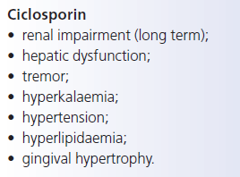
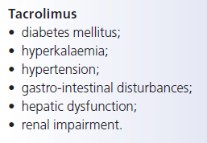
Treatment of NS

